Slide 1
Programming Principles and Techniques
FILE MANIPULATIONS
Notes:
1-13

Slide 2
Learning Outcomes
By the end of this session, you should be able to:
Use C to support file manipulation;
Open and close files using fopen() and fclose() functions; and
Input data from file and channel output to a file using special functions.
Notes:
1-13

Slide 3
File Support in C
Previously, you have learnt interactive input through keyboard and see the output on the screen.
Input data is not permanent. When the program is terminated, data is also gone.
To keep data permanently, we need to use file functions that will allow reading and writing of data files.
Notes:
1-13

Slide 4
File Format Types
There are two types of file formats: text files and binary files.
We will concentrate only for text files.
Text files contain sequential characters that are normally kept in secondary storage like hard disk.
Notes:
1-13

Slide 5
File Format Types (cont.)
Text files can be created using text editor.
Every text file will have termination character at the end of the file (EOF).
Every line of text file contains the newline character as indicator for new line of text.
Notes:
1-13

Slide 6
File Format Types
Assume we create a text file with these three sentences, and did not press enter key for the last sentence:
        Sentence 1
        Sentence 2
        Sentence 3
In the text file, they are recognised like this:
  Sentence 1<newline>Sentence 2<newline>Sentence 3<eof>
Notes:
1-13

Slide 7
File Access Type
There are two ways to access data: sequential access and random access
Ways of access influence how the data is read, written, updated and deleted by the program.
When data is accessed sequentially, it will be accessed by the way it was written.
Accessing data sequentially is like playing music on a cassette player. We need to play in sequence.
Random access – data is accessed in any order
<number> - 13
Notes:
1-13

Slide 8
fopen()
Before any operation can be carrried out, we must open the file using this syntax:
  fopen(file_name, access_mode);
The fopen() function returns a pointer to the opened file
This pointer is used in the operations that are carried out on the file
  FILE *fptr;
  fptr=fopen(“datafile”, “r”);
Notes:
1-13

Slide 9
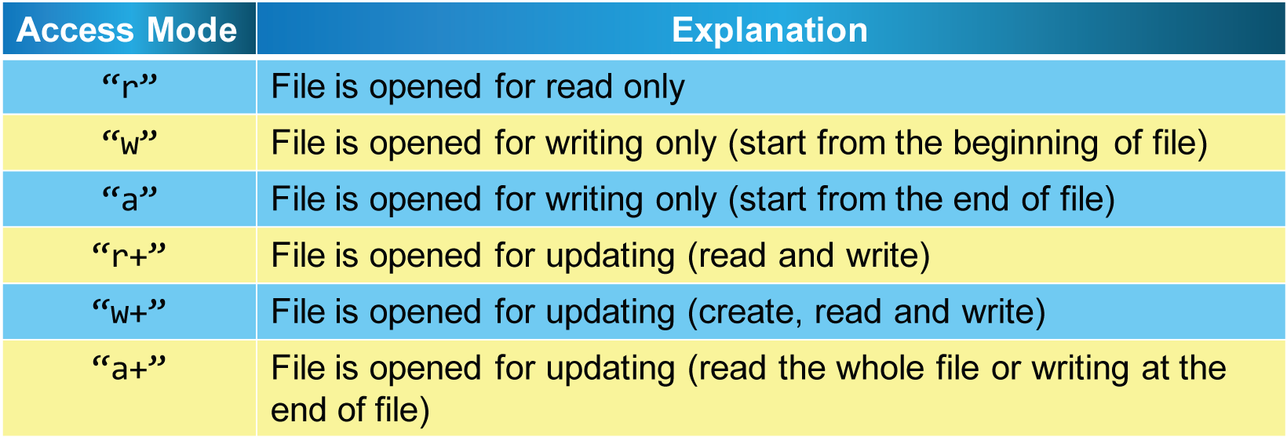
Acess Modes
Notes:
1-13

Slide 10
fopen()
Sometimes the file need to be opened cannot be opened, where the file does not exist.
fopen() function will return a null pointer if it fails to open the file in required mode.
  fptr=fopen(“inputfile”, “r”);
  if(fptr == NULL){
  printf(“File cannot be opened\n”);
  exit(1);
  }
To use exit(), you need to include preprocessor #include<stdlib.h>
Notes:
1-13

Slide 11
fclose()
When we have finished operating on a file, the file needs to be closed, using fclose();
    #include <stdio.h>
    #include <stdlib.h>
    void main()
    {
    FILE *fptr;
    fptr=fopen(“datafile”, “r”);
    if(fptr=NULL){
    printf(“File cannot be opened\n”);
    exit(1);
    }
    fclose(fptr);
    }
Notes:
1-13

Slide 12
fprintf()
We can use the fprintf() function to print all types of data from a file
  fprintf(fptr, output_format [, value_list]);
Calls to the fprintf() function is nearly the same as calling the printf() function
The difference with printf() is that it has an additional parameter – a file pointer
printf() – to print on a screen
fprintf() – to print on a data file
Notes:
1-13

Slide 13
fprintf()
#include <stdio.h>
#include <stdlib.h>
void main()
{
FILE *fptr;
int x, power2;
fptr=fopen(“output”, “w”);
if(fptr==NULL){
printf(“Output file cannot be opened\n”);
exit(1);
}
for(x=1; x<=100; x++){
power2=x*x;
fprintf(fptr, “%d\n”, power2);
}
fclose(fptr);
}
Notes:
1-13

Slide 14
fscanf()
The fscanf() function can be used to read many types of data from a file.
  fscanf(fptr, input_format [,value_list]);
Same like fprintf() function, the difference between scanf() and fscanf() is the file pointer.
scanf() – to read input from keyboard
fscanf() – to read input from a data file
Notes:
1-13

Slide 15
fscanf()
#include <stdio.h>
#include <stdlib.h>
void main()
{
FILE *fptr;
int x, total, matricno;
char gr;
fptr=fopen(“data1”, “r”);
if(fptr==NULL){
printf(“Output file cannot be opened\n”);
exit(1);
}
fscanf(fptr, “%d”, &total);
for(x=1; x<total; x++){
fscanf(fptr, “%d %c”, &matricno, &gr);
printf(“Matric No: %d\tGrade: %c\n”, matricno, gr);
}
fclose(fptr);
}
Notes:
1-13

Slide 16
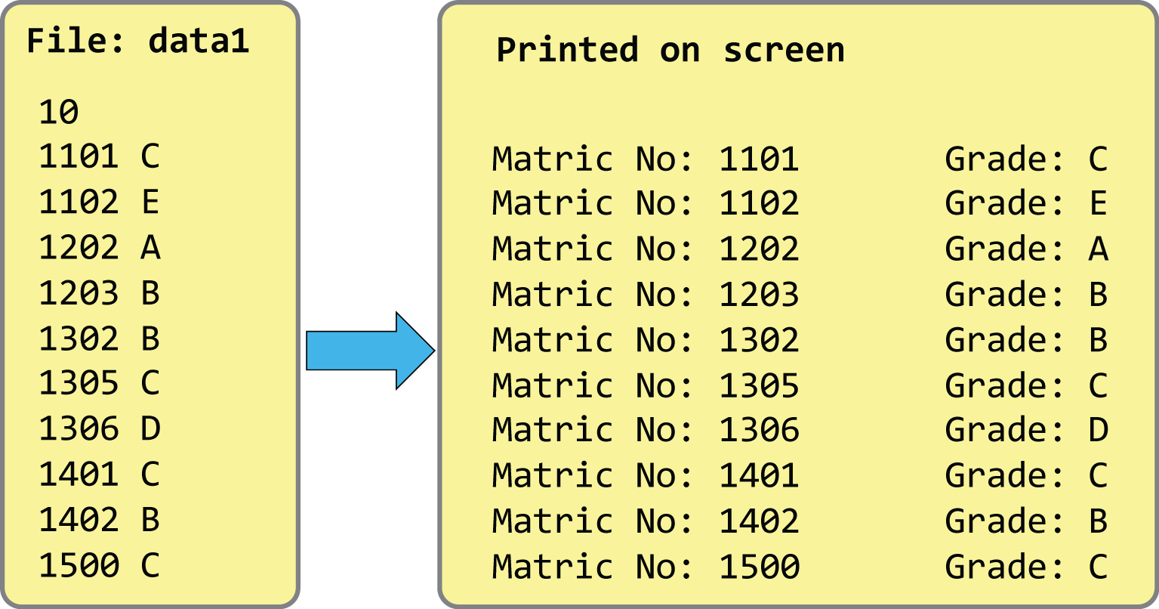
fscanf()
Notes:
1-13

